Slide 1

URAF-KSA.com
Website

Slide 2
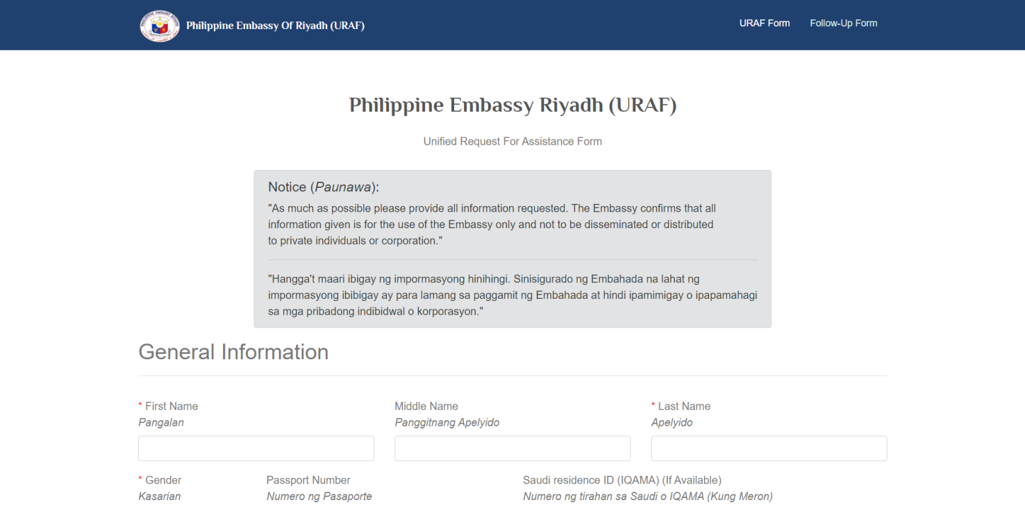
URAF-Form Fill up all the information

Slide 3
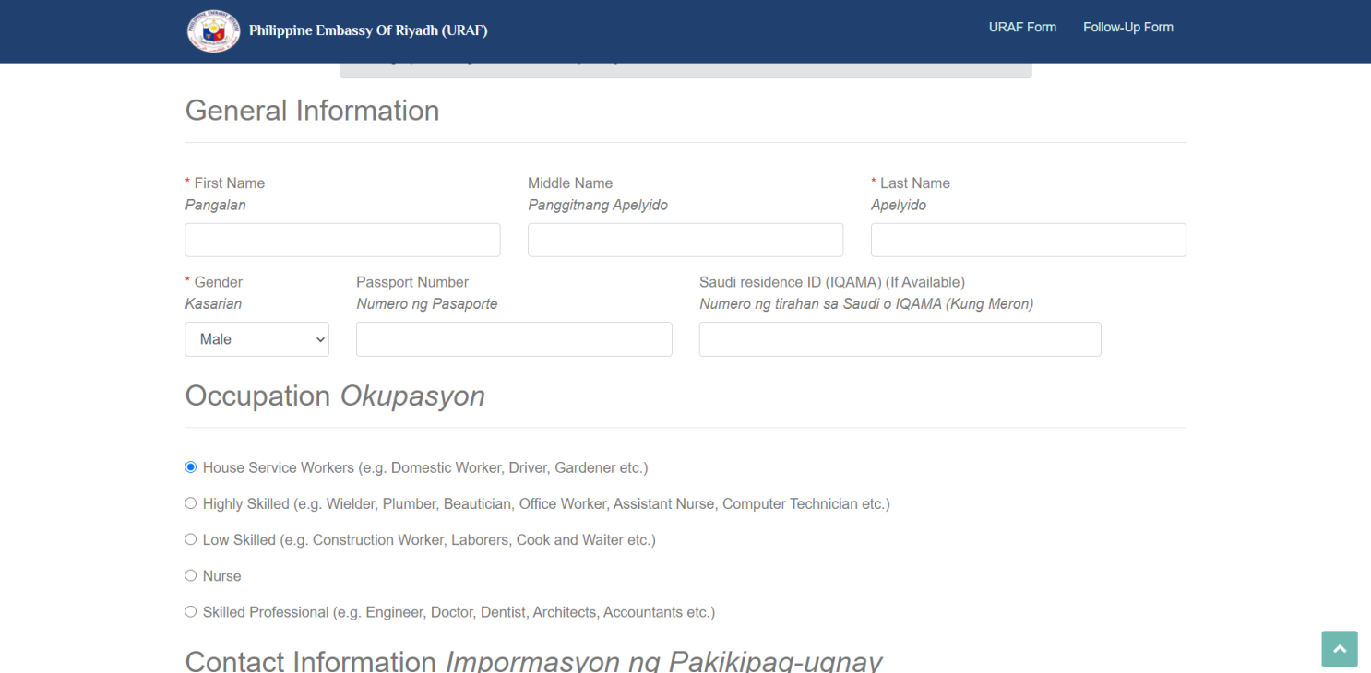
General Information

Slide 4
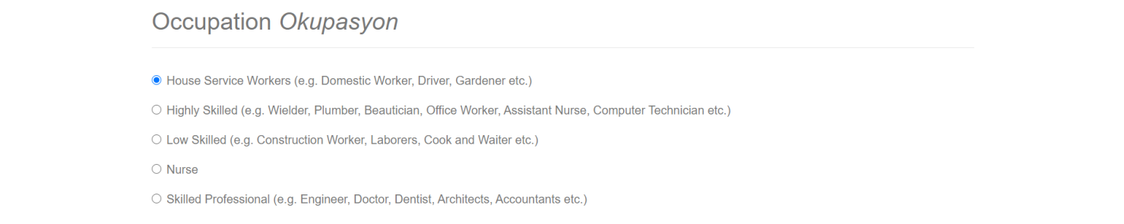
Occupation

Slide 5
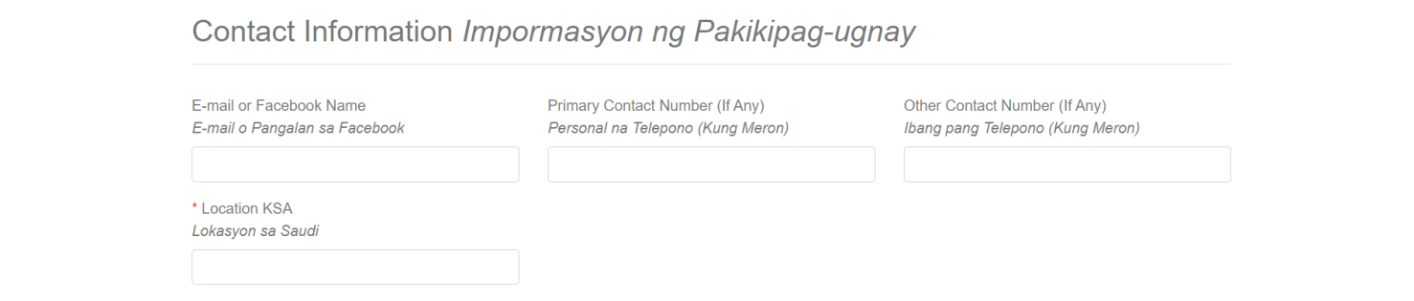
Contact Information

Slide 6
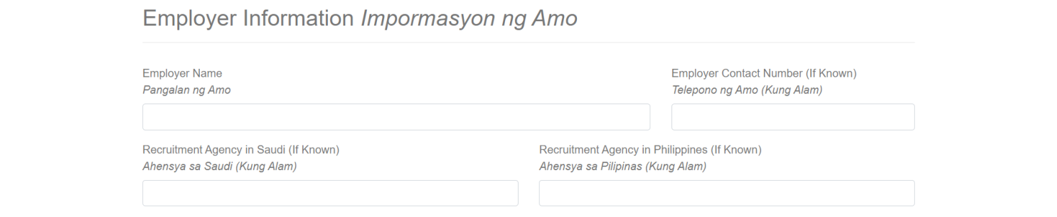
Employer Information

Slide 7
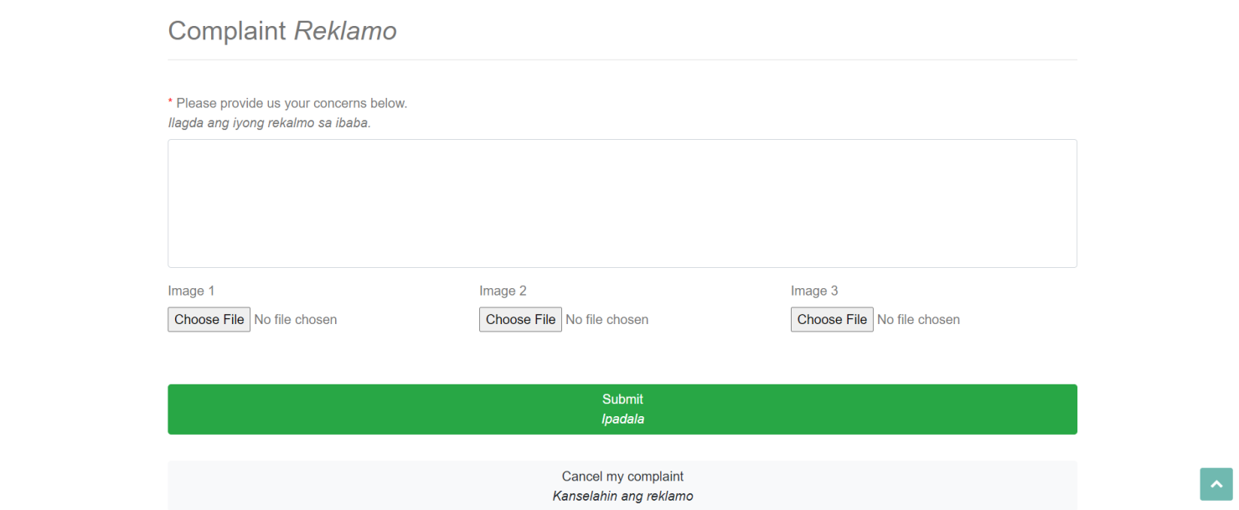
Complaint
Click Submit
If you are done

Slide 8
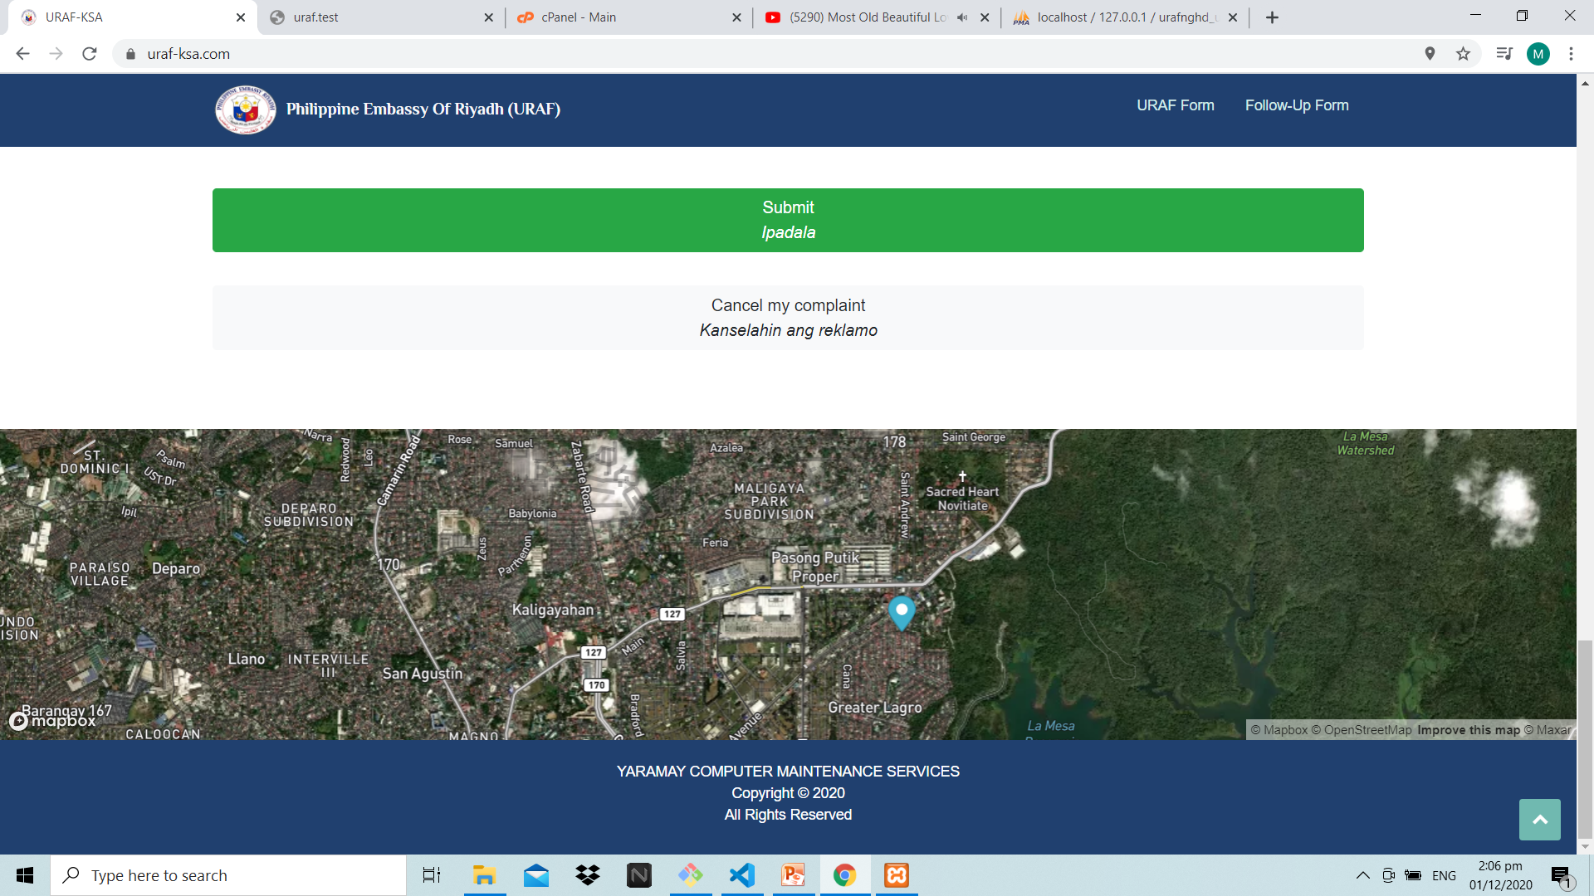
Exact Location

Slide 9
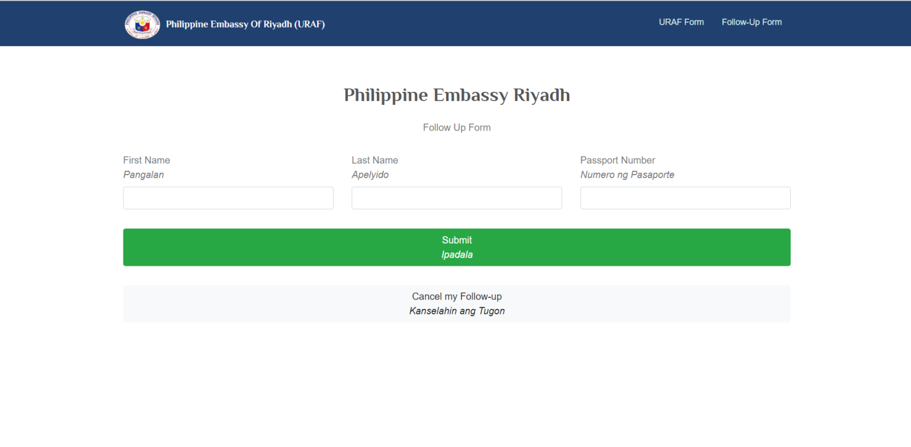
Follow Up-Form
Tina
Abasolo
P9022987A

Slide 10
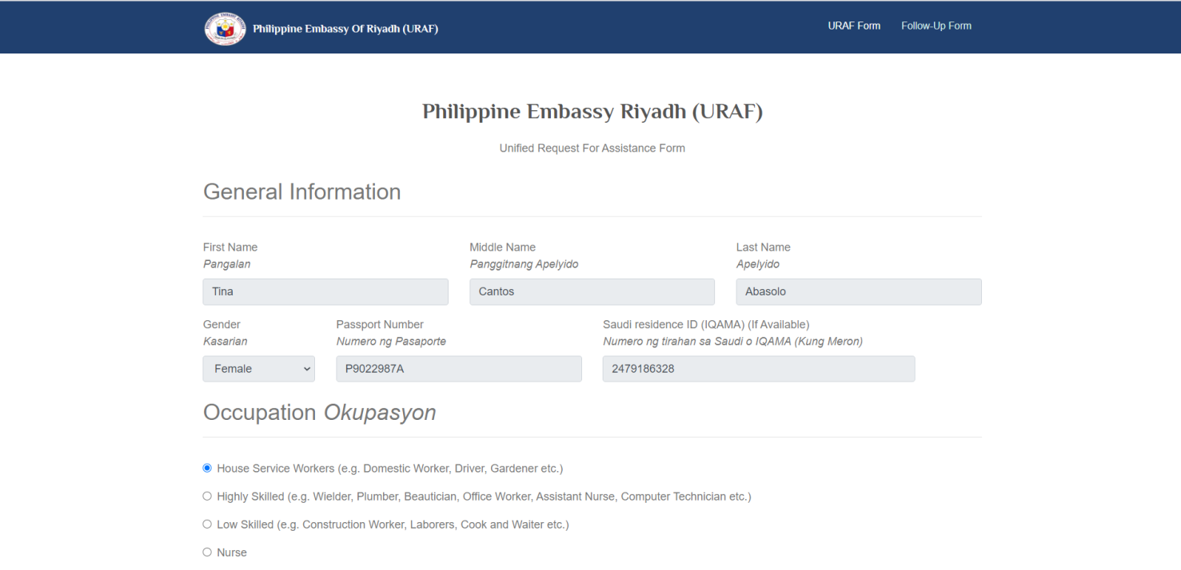
View All the Information

Slide 11
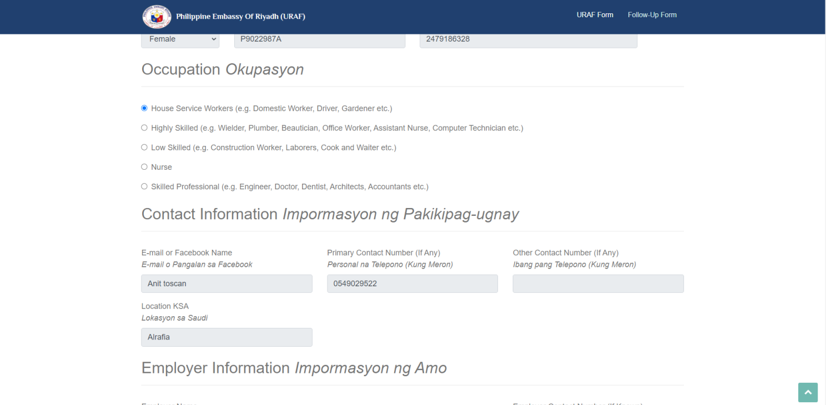

Slide 12
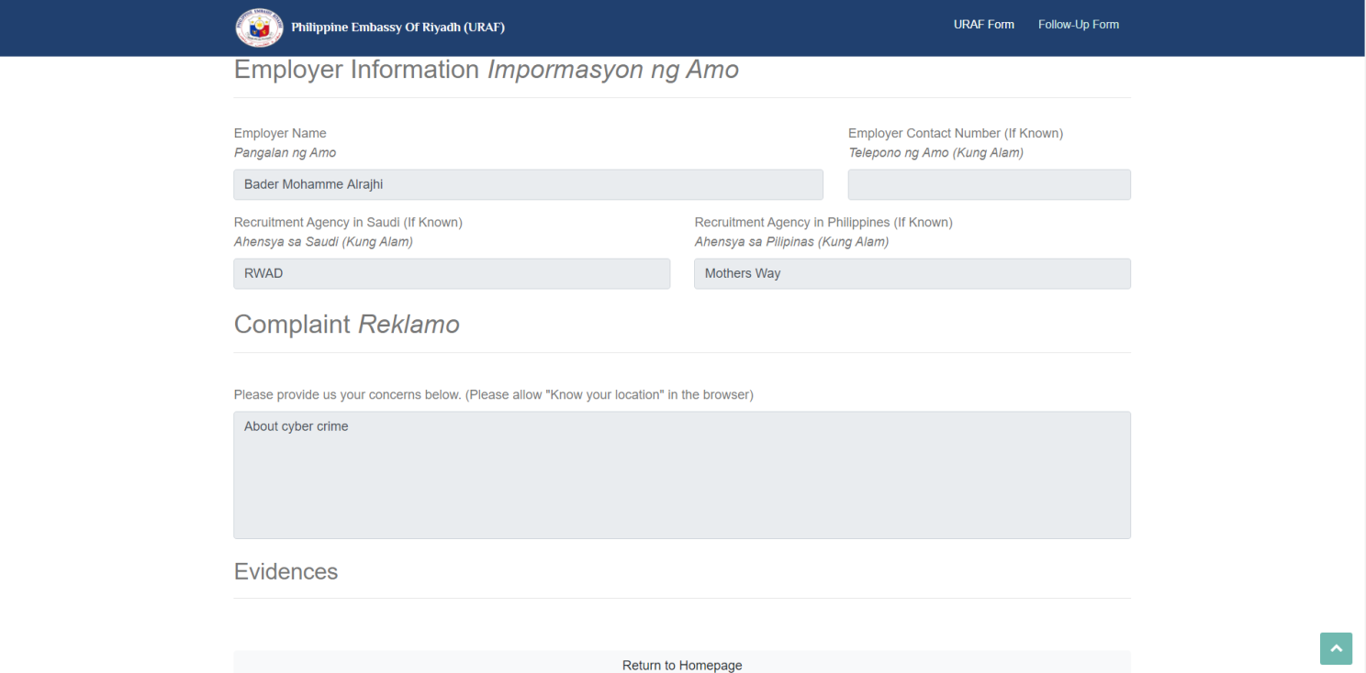

Slide 13
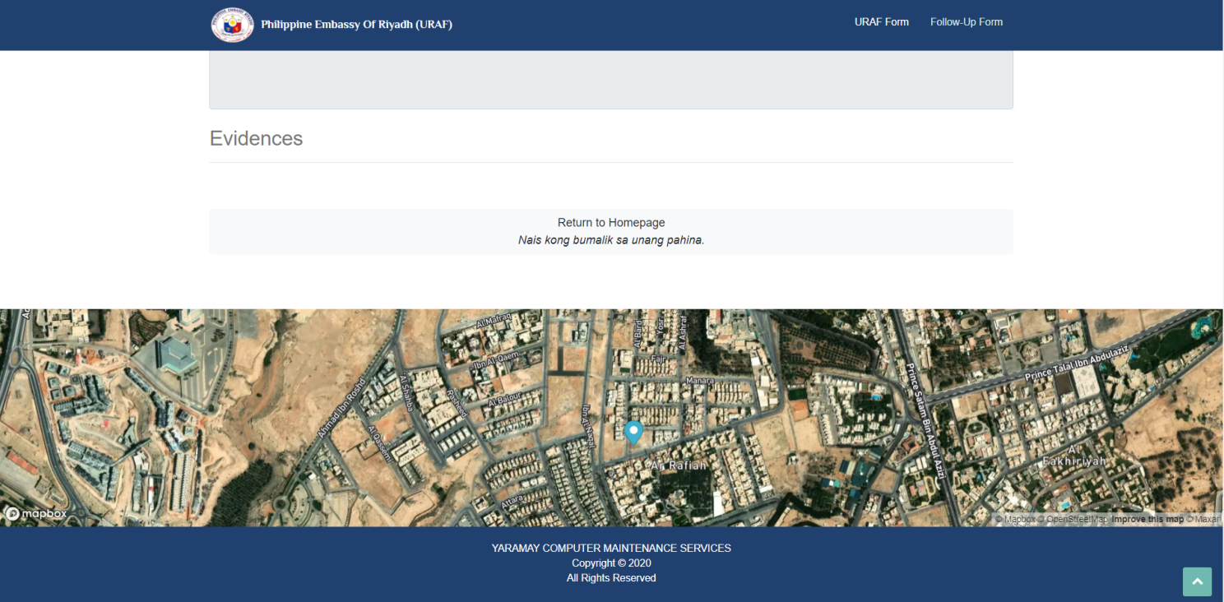
Location

Slide 14
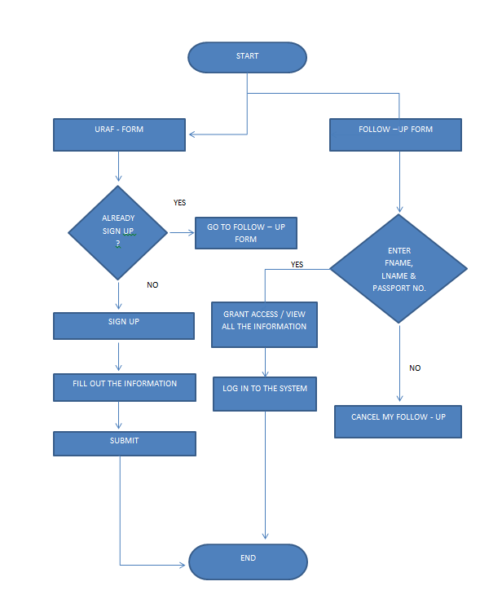
FLOWCHART

Slide 15
uraf-ksa.com/permission
System

Slide 16
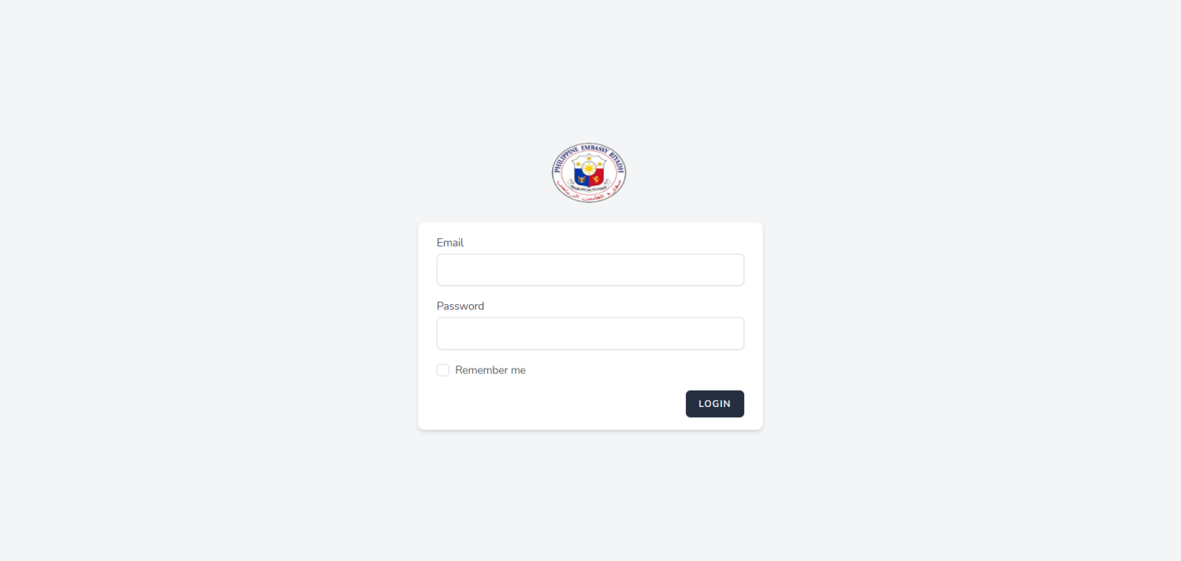
Login as Admin
Email: admin@uraf-ksa.com
Password: password

Slide 17
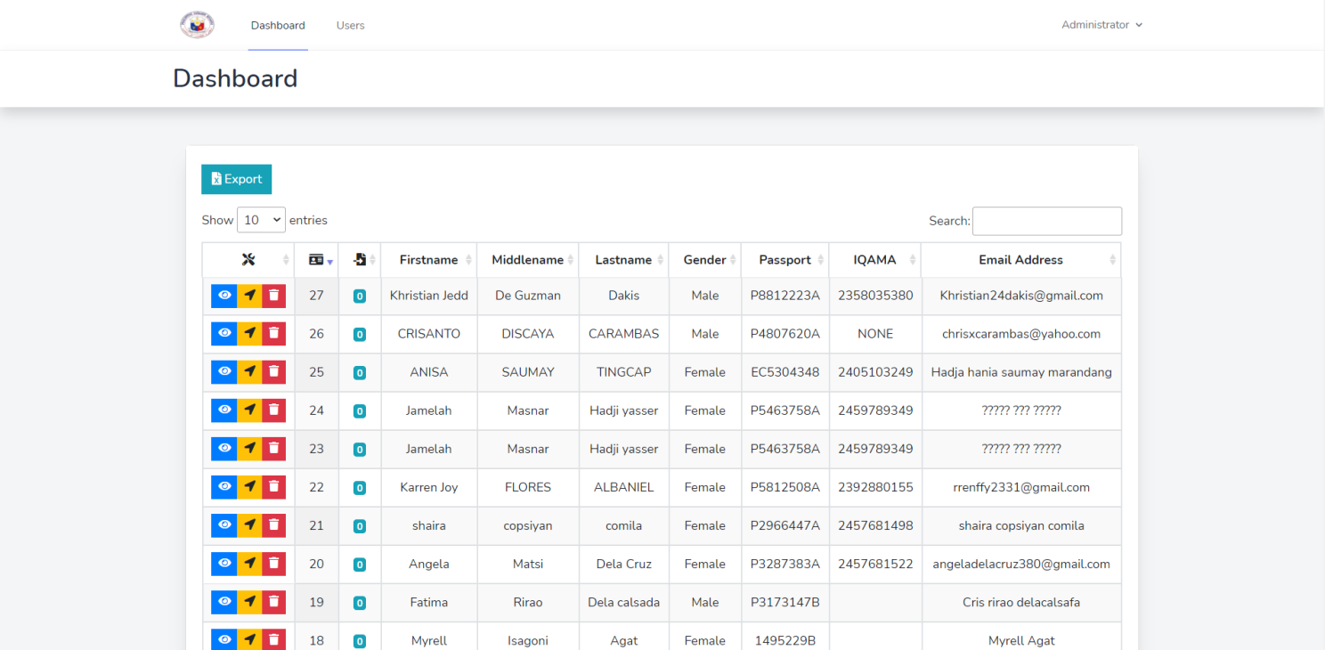
Admin Dashboard

Slide 18
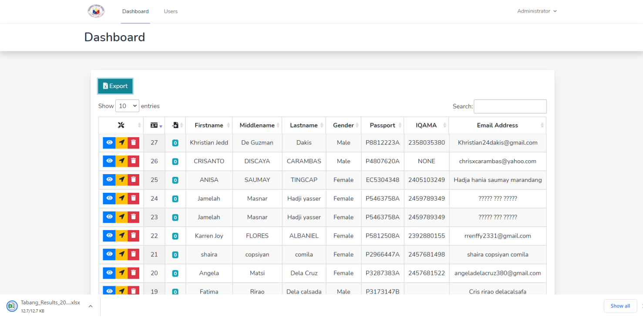
Export

Slide 19
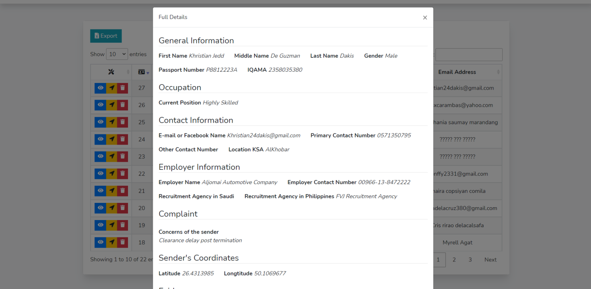
View Full Details

Slide 20
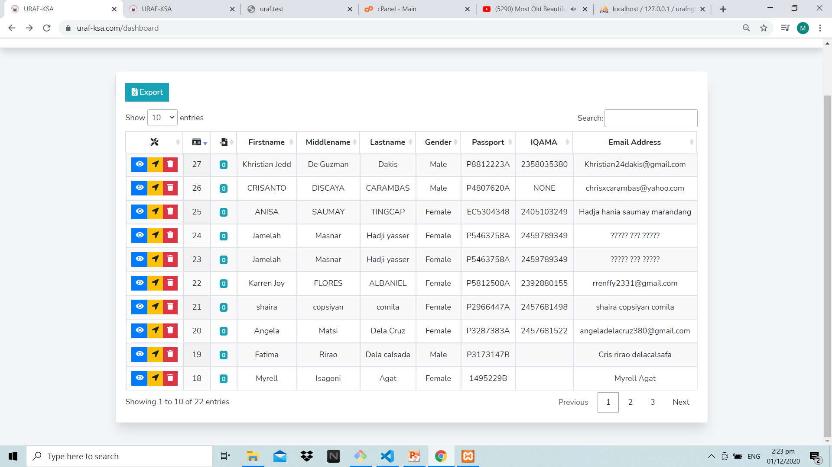
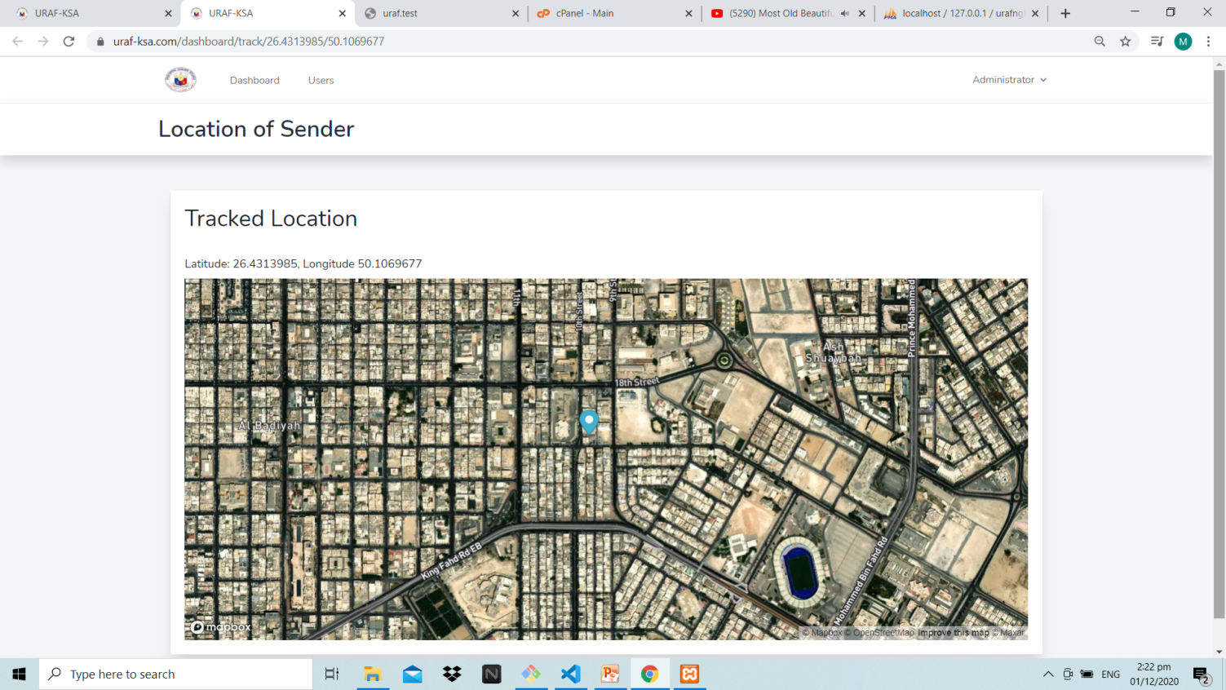
View Location click this icon to see the location

Slide 22
Thank you …

